Slide 3

Georgi Ivanov
Automation Technology Lead trying to distil the knowledge from out daily tasks @KPMG
Toolmaker @myFreeTime
Organizer of @PUGBG
github.com/gogbg

Slide 4

What to expect
How “placeholders” look like
Finding “placeholders”
Replacing “placeholders”
What are the use cases
Advanced scenarios
Executable “placeholders”
“placeholder” adaptation
How it works

Slide 5
How “placeholders” look like
Generic placeholder
Executable placeholder
{{firstName}}
{{& $firstName.ToLower()}}
prefix
name
suffix
prefix
execution
sign
name
suffix

Slide 6
Demos
We love Demos!

Slide 7
What are the use cases
Use it where native tools start to bend
Reproduce pipeline locally
Do not make linters angry
Bulk Template parameter files update
Json configuration files

Slide 8
Demos
We love Demos!

Slide 9
Q&A
15 minutes

Slide 10









Slide 11
Slide title
Sample text for your PSDayCH 2024 presentation
We usually prefer demos, use slides with moderation
Think about those at the back of the room, some text might be too small.
Think about accessibility, try to improve the contrast, colours and size of your presentation.

Slide 12
Instructions
Use this template if you want, it’s preferred but not mandatory.
Please make sure our sponsors are mentioned on your first slide after the title.
Do not amend the ratio or the colours of the sponsors’ logo and background.
Update your twitter handle through the master page (see next slides).

Slide 13
Instruction (Continued)
The session is 30 min. (except for follow along sessions)
Then 15min Q&A.
At the end of your 45 min, please leave the room to the next speaker.
You’re welcome to continue the discussion in the Cafeteria lobby.

Slide 14
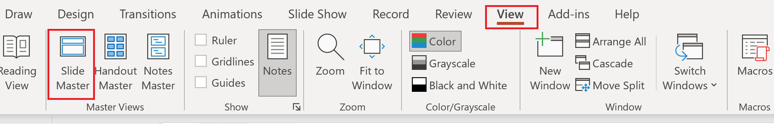
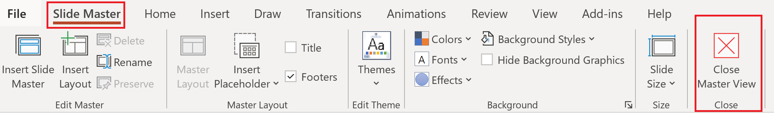
Update the twitter handle on the master slide
To open the slide master:
To close the Master view:
If you need any help, do not hesitate to email us at contact@synedgy.com

Slide 15
Q&A
15 minutes

